Slide 1
Requests Process Direction
DNS Router
Edge Location: find the nearest response server
Requests
Web UI or CLI
Midway Authentication
Responses
Cloudfront: ACM authentication and link to App or Service
Sensai Platform

Slide 2



Sensai Tenant Directory App
Information Collection…
Customers: Onboarding Requests
Path Naming Guidelines
Information Collection…
Information Collected
Failed
Auto Validation and Promotion System
CreateTenant $λ$
Sensai Tenant Table(DB)
generateStagedList $λ$
CloudWatch
Failed
Sensai Team Member
Midway Factory
Staged Tenant List (S3)
Failed
Midway Endpoints
ValidateandPromote $λ$
Succeeded
Live Tenant List (S3)

Slide 3
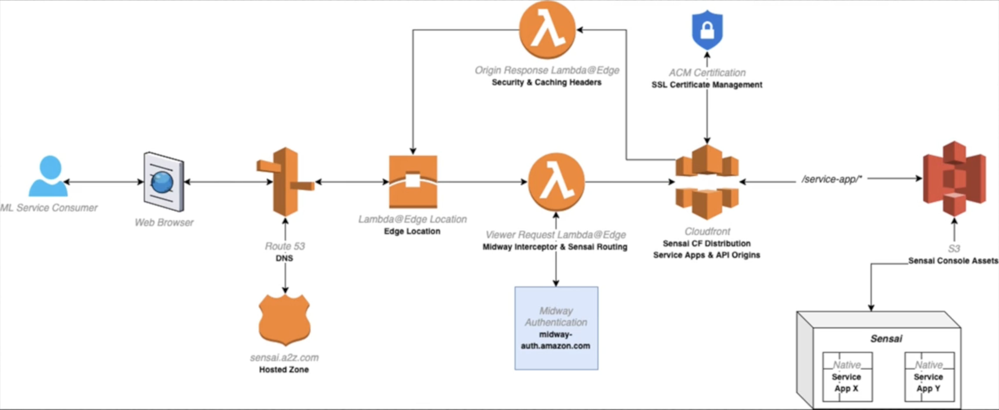

Slide 5
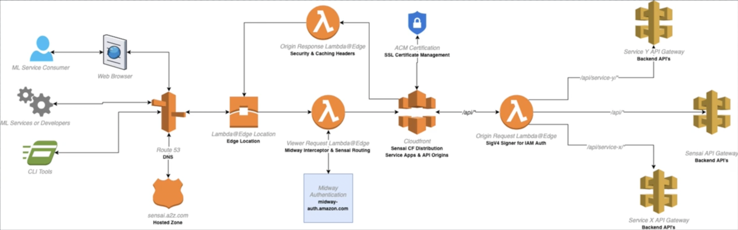

Slide 6
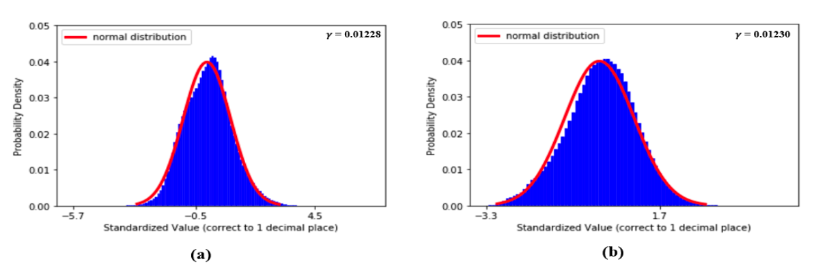
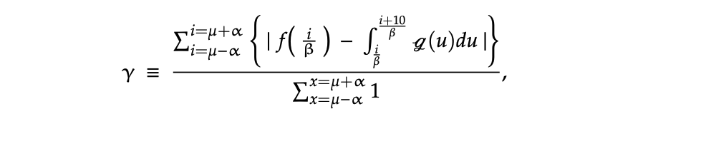

Slide 7


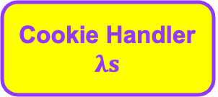






Designed and Modified
Users
Designed and Implemented
$$λ$$
$$GUI$$
Team Members
React.js
CloudFront
Cloud Watch
SNS
Notification System
Route 53
<->
s3
Server
$$λ$$
$$DB$$
DynamoDB Stream
s3
S3 events
$$λ$$
Cookie Handler $λs$
$$λ$$
update/create
update/create
Access Controller
$$APIs/APP$$
DynamoDB
Access Control

